Slide 1
All Life Bank-Unsupervised Learning
Sandhya Nair
April 2021

Slide 2
Objective
To identify different segments in the existing customer based on their spending patterns as well as past interaction with the bank.
Key Questions
Perform EDA.
Apply Clustering Algorithms and mentions how many clusters are formed ?
How are these segments different from each other?
What are your recommendations to the bank on how to better market to and service these customers?

Slide 3
Data Information
Sl_No :Serial No.
Customer Key
Avg_Credit_Limit
Total_Credit_Cards
Total_visits_Bank
Total_visits_online
Total_calls_made
There are 660 rows and 7 columns

Slide 4
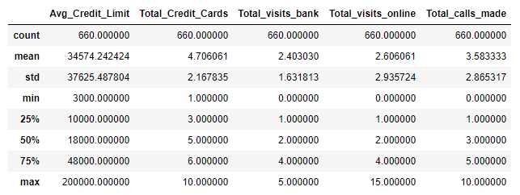
Exploratory Data Analysis
The average number of credit cards held by customers is 5
The average number of
visits(2 visits) made to bank
and visits made online by the
customers are similar but the
maximum number of online
visits are more than in-person
bank visits
Max number of calls made
to the bank is 10.

Slide 5
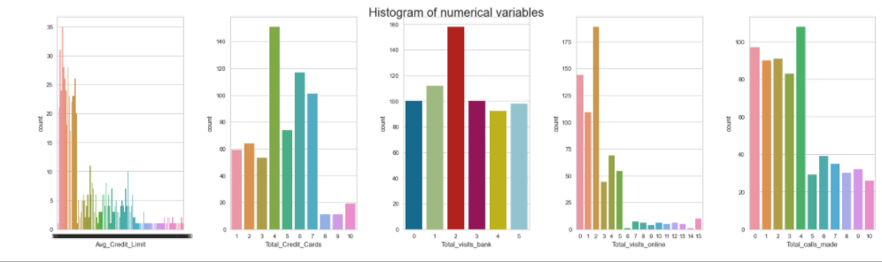
Exploratory Data Analysis
Analysis of Avg_Credit_Limit,Total_Credit_Cards,Total_visits_online,total_visits_bank & Total_calls_made
Avg_Credit_Limit Varies from 3000 to 200000
Most of the customers have 4 credit cards
There has been a max of 2 visits to the bank by most of the customers
Most of the customers made 2 online visits to the bank
The no:of calls made by most of the customers to the bank is 4

Slide 6
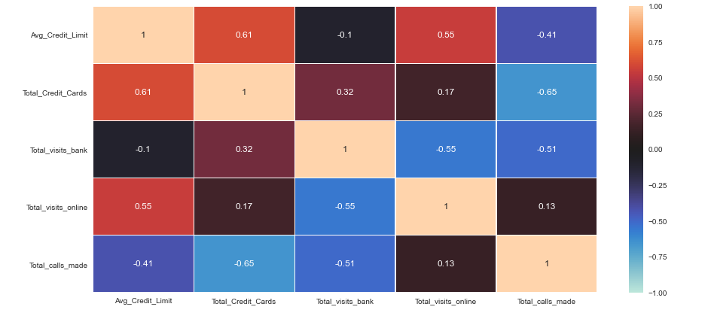
Exploratory Data Analysis
Avg_Credit_Limit and
Total_Credit_Cards are
positively correlated.
Avg_Credit_Limit has
positive correlation with
visits_online but has
negative correlation
in-person visits(Total_visits_bank)
to the bank and calls made to
the bank(Total_calls_made)
Total_calls_made is negatively correlated to total_visits_bank which makes sense .

Slide 7
K-Means Clustering
Steps:
Scale the data set
Perform K-Means Clustering
Select K with Elbow Method
Check the Silhouette Score
Find Optimal Number of Clusters
Perform Cluster Profiling

Slide 8
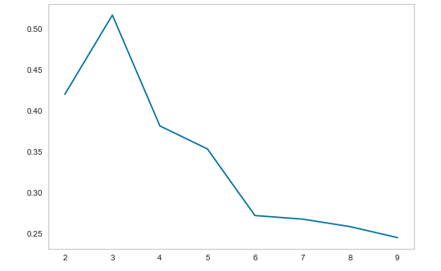
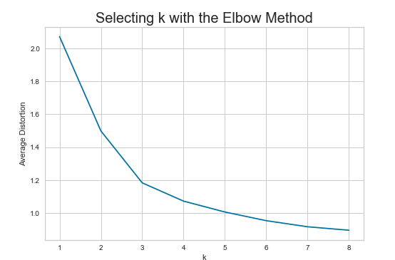
Silhouette Score and Elbow Plot
Silhouette Score Plot Elbow Plot
Appropriate value of k seems to be 4.

Slide 9
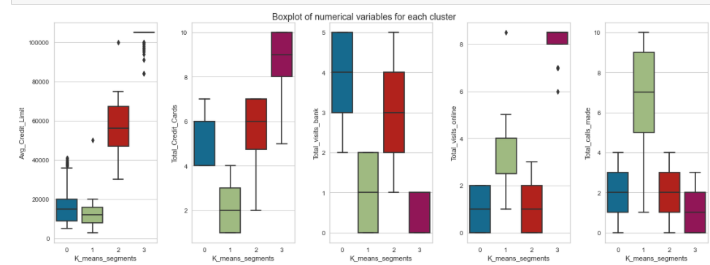
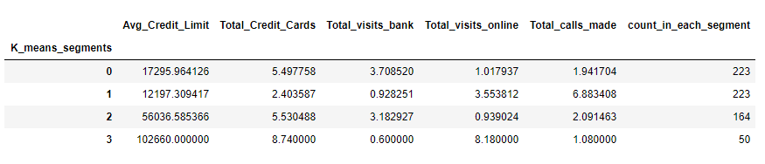
Cluster Profiling-K Means
We have obtained 4 clusters with K-Means

Slide 10
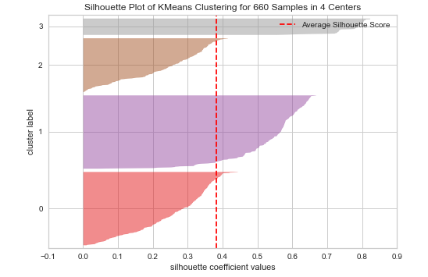
Optimal Number of Clusters
We have chosen 4 as the appropriate no.of clusters as silhouette score is high and there is a Knick at 4 in elbow curve

Slide 11
Insights K-Means
Cluster 0
Avg_Credit_Limit less than 40,000 for majority of customers
Total_credit_cards range from 4 to 7
Total_visits_bank range from 2 to 5
Total_visits_online range from 0 to 2
Total_calls_made range from 0 to 4
Cluster 1
Avg_Credit_Limit less than 30,000 to 78000
Total_credit_cards range from 2 to 7
Total_visits_bank range from 1 to 5
Total_visits_online range from 0 to 3
Total_calls_made range from 0 to 4

Slide 12
Insights K-Means
Cluster 2
Avg_Credit_Limit less than 1000 to 20000
Total_credit_cards range from 1 to 4
Total_visits_bank range from 0 to 2
Total_visits_online range from 1 to 5
Total_calls_made range from 1 to 10
Cluster 3
Avg_Credit_Limit less than 81000 to more than 100000
Total_credit_cards range from 5 to 10
Total_visits_bank range from 0 to 1
Total_visits_online range from 6 and above
Total_calls_made range from 0 to 3

Slide 13
Hierarchical Clustering
Steps
Scale the dataset
Perform Hierarchical Clustering with different Linkage methods & plot Dendrograms
Choose appropriate number of clusters
Perform Cluster Profiling

Slide 14
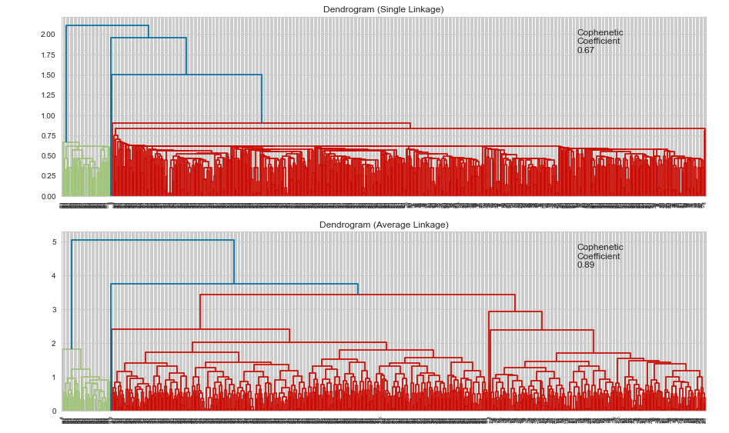
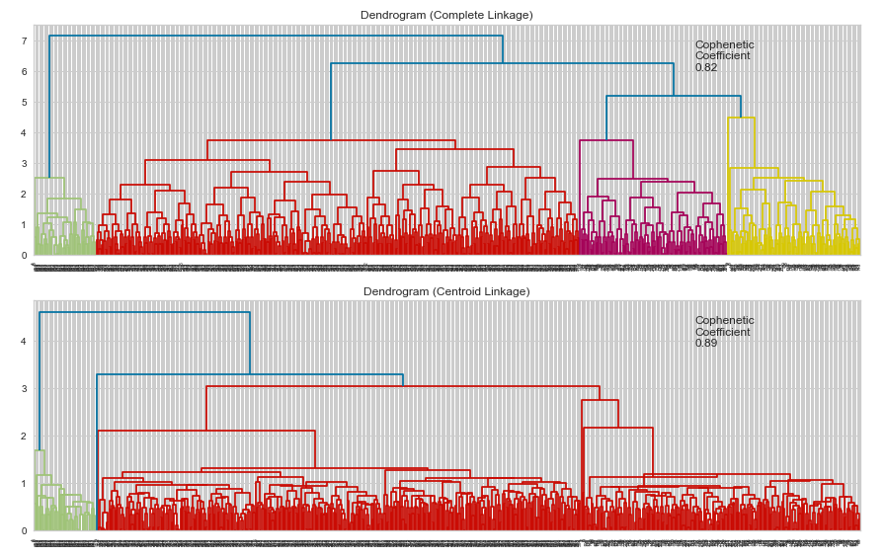
Dendrograms
Dendrograms for the different Linkages

Slide 15
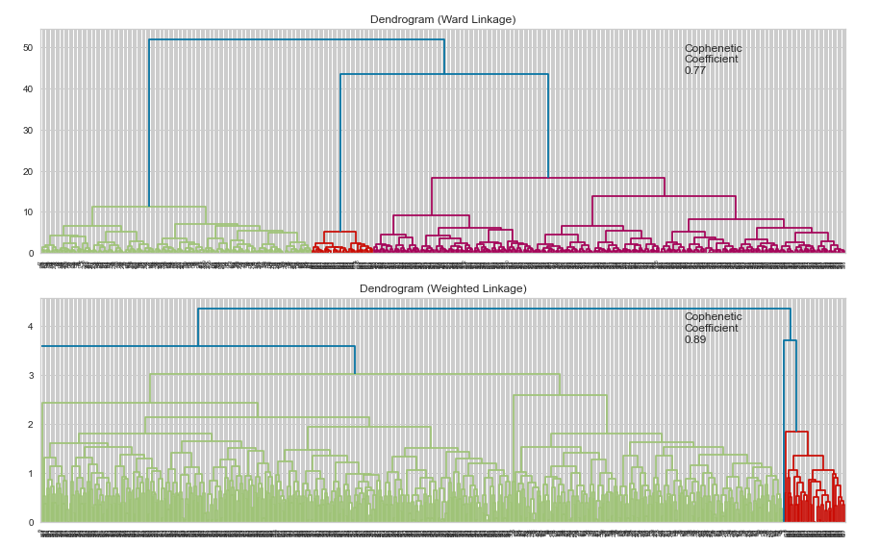
Dendrograms
Dendrograms for the different Linkages
Lets choose Dendrogram with Ward linkage and 4 clusters would be appropriate number of clusters for us

Slide 16
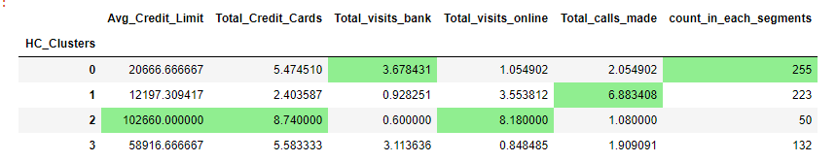
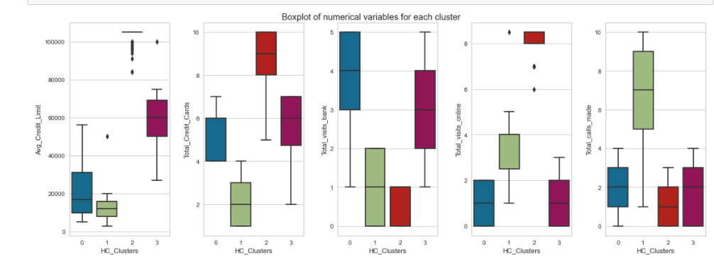
Cluster Profiling Hierarchical Cluster
Cluster Profiling and box plots

Slide 17
Hierarchical Clustering-Insights
Cluster 2
Avg_Credit_Limit ranges from above 80000 to ~150000 for customers in this group
Total_credit_cards range from 5 to 10
Total_visits_bank range from 0 to 1
Total_visits_online range from 6 to 9
Total_calls_made range from 0 to 3
Cluster 3
Avg_Credit_Limit range from about 25000 to 78000
Total_credit_cards range from 2 to 7
Total_visits_bank range from 1 to 5
Total_visits_online range from 0 to 3 visits
Total_calls_made range from 0 to 4

Slide 18
Hierarchical Clustering-Insights
Cluster 0
Avg_Credit_Limit is up to 5000 to ~58000 for customers in this group
Total_credit_cards range from 4 to 7
Total_visits_bank range from 1 to 5
Total_visits_online range from 0 to 2
Total_calls_made range from 0 to 4
Cluster 1
Avg_Credit_Limit is up to 20000 for customers in this group
Total_credit_cards range from 1 to 4
Total_visits_bank range from 0 to 2
Total_visits_online range from 1 to 5
Total_calls_made range from 1 to 10

Slide 19
Conclusion & Business Recommendations
Group 0:The Average Spending customers
These group of customers have median avg_credit_limit and most of their interactions with the bank are in person with very few online visits and low number of calls made to the bank.The bank can target to make the customers use more of the online services and reduce in person visits by providing better customer service
Group 1:The Low Spending Customers
These group of customers have low avg_credit_limit and hold the least number of credit cards. Their interactions with the bank are mostly through online and calls made to the bank.The bank can target the customers to increase their average spending by providing more offers and options to chose for better credit cards that suite their needs.

Slide 20
Conclusion & Business Recommendations
Group 2:The High Spending Customers
These group of customers have high avg_credit_limit and hold the highest number of credit cards. Their interactions with the bank are mostly online.The bank should continue to provide good services to these group of customers
Group 3:The Above Avg Spending Customers
The group of customers have above average credit line .Their interactions with the bank are mostly in person.The Bank should provide more options to maintain increase their credit line and better customer service.

